Slide 1
Python Training
Basics

Slide 2
Contents
Python basic etiquettes
Data types
Control Structures
Python Libraries for Data Science
Pandas basics

Slide 3
Python basic
Things to remember
Comments
Assignment
Operators
Naming Rules
Key words
Built-in data types
Basic knowledge of scripting language.
Do’s and Dont’s
What’s new
What’s different

Slide 4
Things to remember
Indentation matters to code meaning
Block structure indicated by indentation
First assignment to a variable creates it
Variable types don’t need to be declared.
Python figures out the variable types on its own.
Assignment is = and comparison is ==
For numbers + - * / % are as expected
Special use of + for string concatenation and % for string formatting (as in C’s printf)
Logical operators are words (and, or, not) not symbols
The basic printing command is print
Whitespaces
Whitespace is meaningful in Python: especially indentation¹ and placement of newlines
Use a newline to end a line of code
Use \ when must go to next line prematurely
No braces {} to mark blocks of code, use consistent indentation instead
First line with less indentation is outside of the block
First line with more indentation starts a nested block²
Colons start of a new block in many constructs, e.g. function definitions, then clauses

Slide 5
Comments
Start comments with #, rest of line is ignored
Can include a “documentation string” as the first line of a new function or class you define
Development environments, debugger³, and other tools use it: it’s good style to include one
Example:
def fact(n):
“““fact(n) assumes n is a positive integer and returns factorial of n.”””
#assert(n>0)
if n==1 :
return 1
else:
return n*fact(n-1)

Slide 6
Assignment
Binding a variable in Python means setting a name to hold a reference to some object
Assignment creates references, not copies
Names in Python do not have an intrinsic type, objects have types
Python determines the type of the reference automatically based on what data is assigned to it
You create a name the first time it appears on the left side of an assignment expression: x = 3
A reference is deleted via garbage collection after any names bound to it have passed out of scope
Python uses reference semantics (more later)

Slide 7
Operators
Basic operators :
+ addition
- subtraction
/ division
** exponentiation
% modulus (remainder after division)‏
Comparison Operators:
== : is equal to?
!= : not equal to
> : greater than
< : less than
>= : greater than or equal to
<= : less than or equal to
is : We’ll see its use later in the course
Logical Operators:
and, or, not >>> 2+2==5 or 1+1==2 True >>> 2+2==5 and 1+1==2 False >>> not(2+2==5) and 1+1==2 True
Note: We do NOT use &&, ||, !, as in C!

Slide 8
Naming Rules
Names are case sensitive and cannot start with a number.
They can contain letters, numbers, and underscores.
bob Bob _bob _2_bob_ bob_2 BoB
The key words are reserved words and cannot be used as names.
The Python community has these recommended naming conventions
joined_lower for functions, methods and, attributes
joined_lower or ALL_CAPS for constants
StudlyCaps for classes
camelCase only to conform to pre-existing conventions
Attributes: interface, _internal, __private

Slide 9
Keywords (Python 3.8)
False | await | else | import | pass
None | break | except | in | raise
True | class | finally | is | return
and | continue | for | lambda | try
as | def | from | nonlocal | while
assert | del | global | not | with
async | elif | if | or | yield

Slide 10
Built-in Types in Python
Type Category | Type Name | Description
None | types.NoneType | The null object None
Numbers | int | Integer
 | long | Arbitrary-precision integer
 | float | Floating point
 | complex | Complex number
 | bool | Boolean (True or False)
Sequences | str | Character string
 | unicode | Unicode character string
 | basestring | Abstract base type for all strings
 | list | List
 | tuple | Tuple
 | xrange | Returned by xrange()
Mapping | dict | Dictionary
Sets | set | Mutable set
 | frozenset | Immutable set
Files | file | File
Notes:
The principal built-in types are numerics, sequences, mappings, files, classes, instances and exceptions.

Slide 11
Basic Datatypes
Integers (default for numbers)
z = 5 / 2 # Answer 2, integer division
Floats
x = 3.456
Strings
Can use “” or ‘’ to specify with “abc” == ‘abc’
Unmatched can occur within the string: “matt’s”
Use triple double-quotes for multi-line strings or strings than contain both ‘ and “ inside of them: “““a‘b“c”””

Slide 12
Control Structures
If/elif/else
While
For
Range
Break/continue/pass
Control structures in Python
How is it different from other languages
What’s new
What’s different

Slide 13
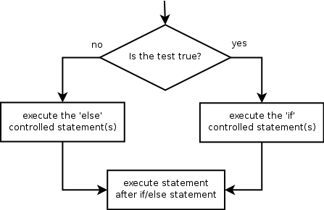
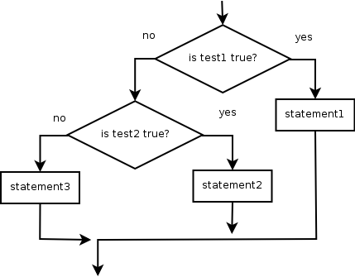
If/else statements
if/else statement: Executes one block of statements if a certain condition is True, and a second block of statements if it is False.
Syntax:
if condition:
statements
else:
statements
Example:
gpa = 1.4
if gpa > 2.0:
print "Welcome to Mars University!"
else:
print "Your application is denied."
Multiple conditions can be chained with elif ("else if"):
if condition:
statements
elif condition:
statements
else:
statements

Slide 14
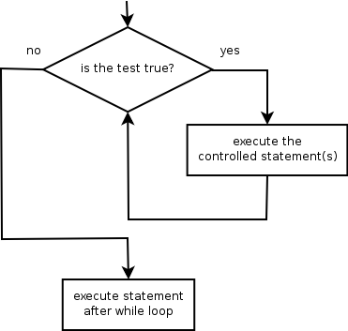
while statement
while loop: Executes a group of statements as long as a condition is True.
good for indefinite loops (repeat an unknown number of times)
Syntax:
while condition:
statements
Example:
number = 1
while number < 200:
print number,
number = number * 2
Output:
1 2 4 8 16 32 64 128

Slide 15
For
for loop: Repeats a set of statements over a group of values.
Syntax:
for variableName in groupOfValues:
statements
We indent the statements to be repeated with tabs or spaces.
variableName gives a name to each value, so you can refer to it in the statements.
groupOfValues can be a range of integers, specified with the range function.
Example:
for x in range(1, 6):
print x, "squared is", x * x
Output:
1 squared is 1
2 squared is 4
3 squared is 9
4 squared is 16
5 squared is 25

Slide 16
range
The range function specifies a range of integers:
range(start, stop) - the integers between start (inclusive)
and stop (exclusive)
It can also accept a third value specifying the change between values.
range(start, stop, step) - the integers between start (inclusive)
and stop (exclusive) by step
Example:
for x in range(5, 0, -1):
print x
print "Blastoff!"
Output:
5
4
3
2
1
Blastoff!
Exercise:

Slide 17
Break, continue
>>> for value in [3, 1, 4, 1, 5, 9, 2]:
... print "Checking", value
... if value > 8:
... print "Exiting for loop"
... break
... elif value < 3:
... print "Ignoring"
... continue
... print "The square is", value**2
… else :
… pass
...

Slide 18
Python Libraries for Data Science
Numpy
Scipy
Pandas
Scikit Learn
Matplotlib and Seaborn
Data structures in Python
Python libraries for data scientists
Data Manipulation
Data visualization
What’s new
What’s different

Slide 19

Python Libraries for Data Science
NumPy:
introduces objects for multidimensional arrays and matrices, as well as functions that allow to easily perform advanced mathematical and statistical operations on those objects
provides vectorization of mathematical operations on arrays and matrices which significantly improves the performance
many other python libraries are built on NumPy
Link: http://www.numpy.org/

Slide 20

Python Libraries for Data Science
SciPy:
collection of algorithms for linear algebra, differential equations, numerical integration, optimization, statistics and more
part of SciPy Stack
built on NumPy
Link: https://www.scipy.org/scipylib/

Slide 21

Python Libraries for Data Science
Pandas:
adds data structures and tools designed to work with table-like data (similar to Series and Data Frames in R)
provides tools for data manipulation: reshaping, merging, sorting, slicing, aggregation etc.
allows handling missing data
Link: http://pandas.pydata.org/

Slide 22

Python Libraries for Data Science
SciKit-Learn:
provides machine learning algorithms: classification, regression, clustering, model validation etc.
built on NumPy, SciPy and matplotlib
Link: http://scikit-learn.org/

Slide 23

Python Libraries for Data Science
matplotlib:
python 2D plotting library which produces publication quality figures in a variety of hardcopy formats
a set of functionalities similar to those of MATLAB
line plots, scatter plots, barcharts, histograms, pie charts etc.
relatively low-level; some effort needed to create advanced visualization
Link: https://matplotlib.org/

Slide 24
Python Libraries for Data Science
Seaborn:
based on matplotlib
provides high level interface for drawing attractive statistical graphics
Similar (in style) to the popular ggplot2 library in R

Slide 25
Pandas basics
Import libraries
Read data
Explore data
Dataframe datatypes
Attributes
Methods
Selection
Filtering
Slicing
loc()/iloc()
Sorting
Reading data in pandas
Handling it
Exploring it
Performing operations on it

Slide 26
Loading Python Libraries
In [ ]:
#Import Python Libraries
import numpy as np
import scipy as sp
import pandas as pd
import matplotlib as mpl
import seaborn as sns
Press Shift+Enter to execute the jupyter cell

Slide 27
Reading data using pandas
In [ ]:
#Read csv file
df = pd.read_csv(“myfile.csv”)
Note: The above command has many optional arguments to fine-tune the data import process.
There is a number of pandas commands to read other data formats:
pd.read_excel('myfile.xlsx',sheet_name='Sheet1', index_col=None, na_values=['NA'])
pd.read_stata('myfile.dta')
pd.read_sas('myfile.sas7bdat')
pd.read_hdf('myfile.h5','df')

Slide 28
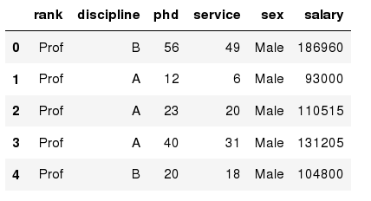
Exploring data frames
In [3]:
#List first 5 records
df.head()
Out[3]:

Slide 29
Data Frame data types
In [4]:
#Check a particular column type
df['salary'].dtype
Out[4]: dtype('int64')
In [5]:
#Check types for all the columns
df.dtypes
Out[4]:
object
object
int64
int64
object
int64
rank
discipline
phd
service
sex
salary
dtype: object

Slide 30
Data Frame data types
Pandas Type | Native Python Type | Description
object | string | The most general dtype. Will be assigned to your column if column has mixed types (numbers and strings).
int64 | int | Numeric characters. 64 refers to the memory allocated to hold this character.
float64 | float | Numeric characters with decimals. If a column contains numbers and NaNs(see below), pandas will default to float64, in case your missing value has a decimal.
datetime64, timedelta[ns] | N/A (but see the datetime module in Python’s standard library) | Values meant to hold time data. Look into these for time series experiments.

Slide 31
Data Frames attributes
Python objects have attributes⁴ and methods⁵.
df.attribute | description
dtypes | list the types of the columns
columns | list the column names
axes | list the row labels and column names
ndim | number of dimensions
size | number of elements
shape | return a tuple representing the dimensionality
values | numpy representation of the data

Slide 32
Data Frames methods
Unlike attributes, python methods have parenthesis.
All attributes and methods can be listed with a dir() function: dir(df)
df.method() | description
head( [n] ), tail( [n] ) | first/last n rows
describe() | generate descriptive statistics (for numeric columns only)
max(), min() | return max/min values for all numeric columns
mean(), median() | return mean/median values for all numeric columns
std() | standard deviation
sample([n]) | returns a random sample of the data frame
dropna() | drop all the records with missing values

Slide 33
Selecting a column in a Data Frame
Method 1: Subset the data frame using column name:
df[‘Regimen']
Method 2: Use the column name as an attribute:
df.Regimen
Note: there is an attribute rank for pandas data frames, so to select a column with a name "rank" we should use method 1.

Slide 34
Data Frame: Filtering
To subset the data we can apply Boolean indexing⁶. This indexing is commonly known as a filter. For example if we want to subset the rows in which the salary value is greater than $120K:
In [ ]:
#Calculate mean salary for each professor rank:
df_sub = df[ df['salary'] > 120000 ]
Any Boolean operator can be used to subset the data:
> greater; >= greater or equal;
< less; <= less or equal;
== equal; != not equal;
In [ ]:
#Select only those rows that contain female professors:
df_f = df[ df['sex'] == 'Female' ]

Slide 35
Data Frames: Slicing
There are a number of ways to subset the Data Frame:
one or more columns
one or more rows
a subset of rows and columns
Rows and columns can be selected by their position or label

Slide 36
Data Frames: Slicing
When selecting one column, it is possible to use single set of brackets, but the resulting object will be a Series (not a DataFrame):
In [ ]:
#Select column salary:
df['salary']
When we need to select more than one column and/or make the output to be a DataFrame, we should use double brackets:
In [ ]:
#Select column salary:
df[['rank','salary']]

Slide 37
Data Frames: Selecting rows
If we need to select a range of rows, we can specify the range using ":"
In [ ]:
#Select rows by their position:
df[10:20]
Notice that the first row has a position 0, and the last value in the range is omitted:
So for 0:10 range the first 10 rows are returned with the positions starting with 0 and ending with 9

Slide 38
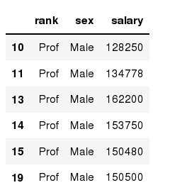
Data Frames: method loc
If we need to select a range of rows, using their labels we can use method loc:
In [ ]:
#Select rows by their labels:
df_sub.loc[10:20,['rank','sex','salary']]
Out[ ]:

Slide 39
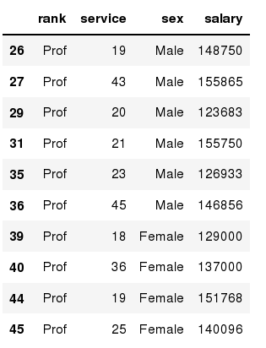
Data Frames: method iloc
If we need to select a range of rows and/or columns, using their positions we can use method iloc:
In [ ]:
#Select rows by their labels:
df_sub.iloc[10:20,[0, 3, 4, 5]]
Out[ ]:

Slide 40
Data Frames: method iloc (summary)
df.iloc[0] # First row of a data frame
df.iloc[i] #(i+1)th row
df.iloc[-1] # Last row
df.iloc[:, 0] # First column
df.iloc[:, -1] # Last column
df.iloc[0:7] #First 7 rows
df.iloc[:, 0:2] #First 2 columns
df.iloc[1:3, 0:2] #Second through third rows and first 2 columns
df.iloc[[0,5], [1,3]] #1st and 6th rows and 2nd and 4th columns

Slide 41
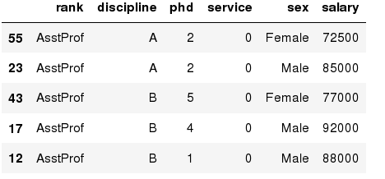
Data Frames: Sorting
We can sort the data by a value in the column. By default the sorting will occur in ascending order and a new data frame is return.
In [ ]:
# Create a new data frame from the original sorted by the column Salary
df_sorted = df.sort_values( by ='service')
df_sorted.head()
Out[ ]:

Slide 42
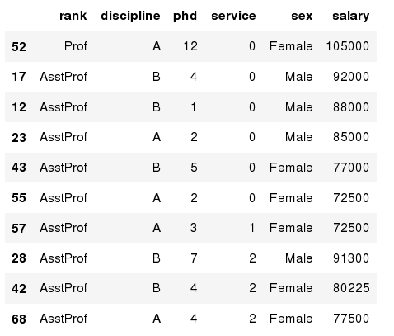
Data Frames: Sorting
We can sort the data using 2 or more columns:
In [ ]:
df_sorted = df.sort_values( by =['service', 'salary'], ascending = [True, False])
df_sorted.head(10)
Out[ ]:

